Slide 1

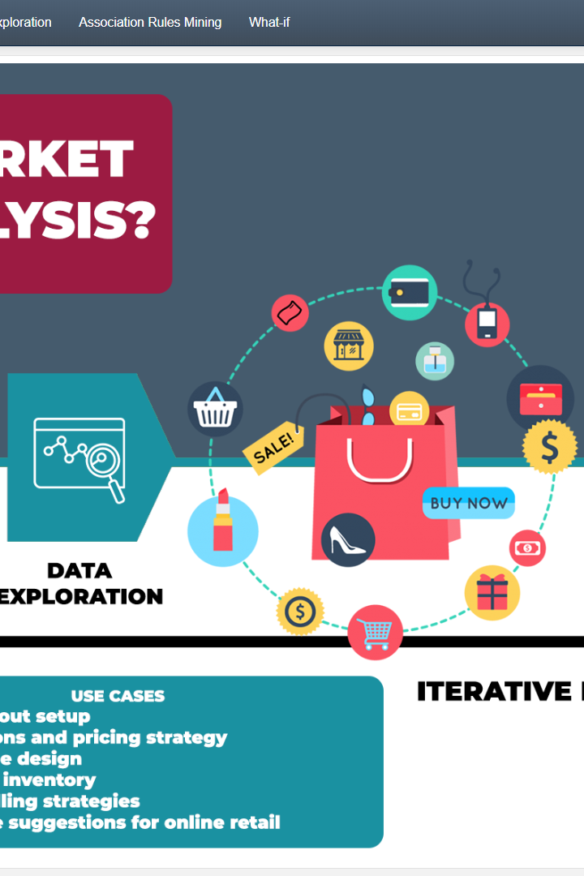
Market basket insights
Discover the power of market basket analysis and learn how to use metrics, techniques, and tools to gain insights into customer behavior.
B

Slide 2
What are Market Baskets?
Market baskets are groups of items that customers frequently purchase together. By analyzing them, we can gain insights into customer patterns and preferences.
Association rules
Clustering analysis
Collaborative filtering
This technique identifies frequent item sets and generates rules that describe their relationships.
This technique groups together similar items and helps identify segments of customers with differing interests.
This technique recommends items to customers based on purchasing patterns of similar customers.

Slide 3

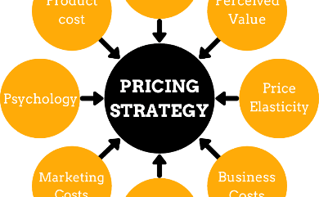

Why is Market Basket Analysis Important?
Market basket analysis provides insights into customer behavior that can be used to optimize various aspects of a business such as marketing, pricing, and product placement.
Product Placement
Pricing Strategies
Email Advertising
Knowing which items are frequently purchased together can inform how items are placed on store shelves and in ads.
Market basket analysis can help identify price points that encourage customers to purchase multiple items.
Personalized recommendations can be generated based on previous customer purchases.

Slide 4
Common Metrics for Market Basket Analysis
There are several key metrics that are used in market basket analysis to gain insights into customer behaviour. These include:
1
Support
2
Confidence
The proportion of transactions that include the item set.
The proportion of transactions that include the item set and also include another item.
3
Lift
The ratio of observed support to expected support. A value greater than 1 indicates a positive association.

Slide 5
Techniques for Analyzing and Visualizing Market Basket Data
The power of market basket analysis lies in the ability to identify hidden patterns among purchases. To do so, we can use various techniques such as:
1
Heat Maps
Visualize the relationship among different products with colours based on how often they appear together.
Chord Diagrams
2
Visualize the relationship among different products with arcs or ribbons based on how often they appear together.
3
Trees
Visualize hierarchical relationships among different products based on customer purchase patterns.

Slide 6
Real-world applications of market basket insights
Market basket analysis is widely used in various industries to generate insights and optimize business practices. Here are some examples:
Grocery Stores
E-commerce
Restaurants
Adjust store layouts to better group frequent item purchases together.
Recommend similar products to customers based on their past purchase history.
Create combo deals to entice customers to purchase groups of related items.

Slide 7
Surprising Insights from Market Basket Analysis
Market basket analysis often reveals surprising and unexpected customer behaviour. Here are some surprising insights:
1
Beer and Diapers
Men who were sent to purchase diapers were also likely to purchase beer.
Avocado Toast and Coffee
2
Customers who purchased avocado toast also tended to purchase coffee.
3
Paint and Diapers
A study found that parents who have small children are likely to purchase paint.

Slide 8

Conclusion and Future Outlook
Market basket analysis provides invaluable insights into customer behaviour that can help businesses optimize their marketing, pricing, and product placement strategies. As the volume and complexity of data increases, powerful machine learning models are being developed to generate even deeper insights.

